Slide 1
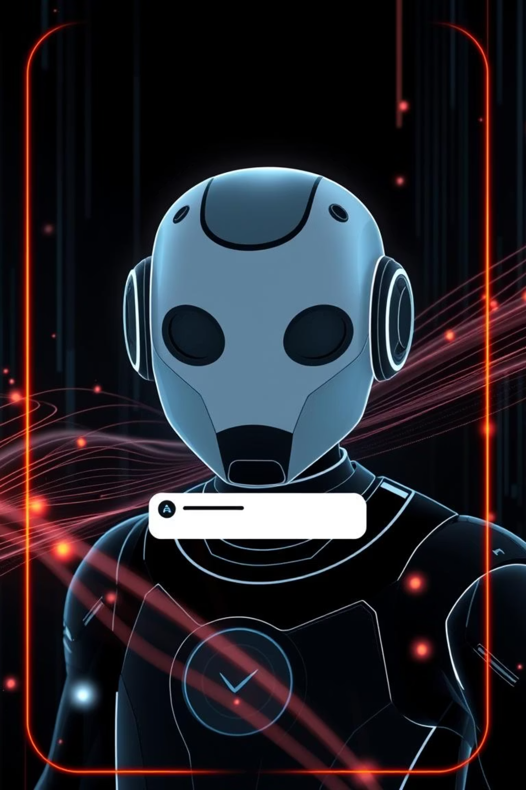

E-Commerce Chatbot with Login & Chat History
An advanced e-commerce chatbot simulation, featuring user authentication, persistent chat history, and dynamic product information retrieval. This project was developed as part of the Uplyft.ai Internship Case Study, demonstrating practical full-stack development skills.
by Swapnil Gite

Slide 2

Project Overview & Problem Statement
The core problem addressed by this project is the simulation of a smart e-commerce chatbot designed to enhance user experience by providing product search capabilities, personalized activity tracking, and seamless retention of conversation history across multiple sessions. This initiative aimed to create a robust and user-centric solution for the Uplyft.ai Internship Case Study in June 2025.

Slide 3
Key Features Implemented
User Authentication
Implemented a secure login and logout system for static users.
Product Search
Chatbot returns detailed product information from a products.json file.
Persistent Chat History
Individual chat histories are stored in chat_history.json and auto-loaded upon user login.
Separated Architecture
Frontend and backend are designed as distinct, decoupled modules.
Local Hosting
Project is hosted locally via a Flask backend for easy deployment.

Slide 4
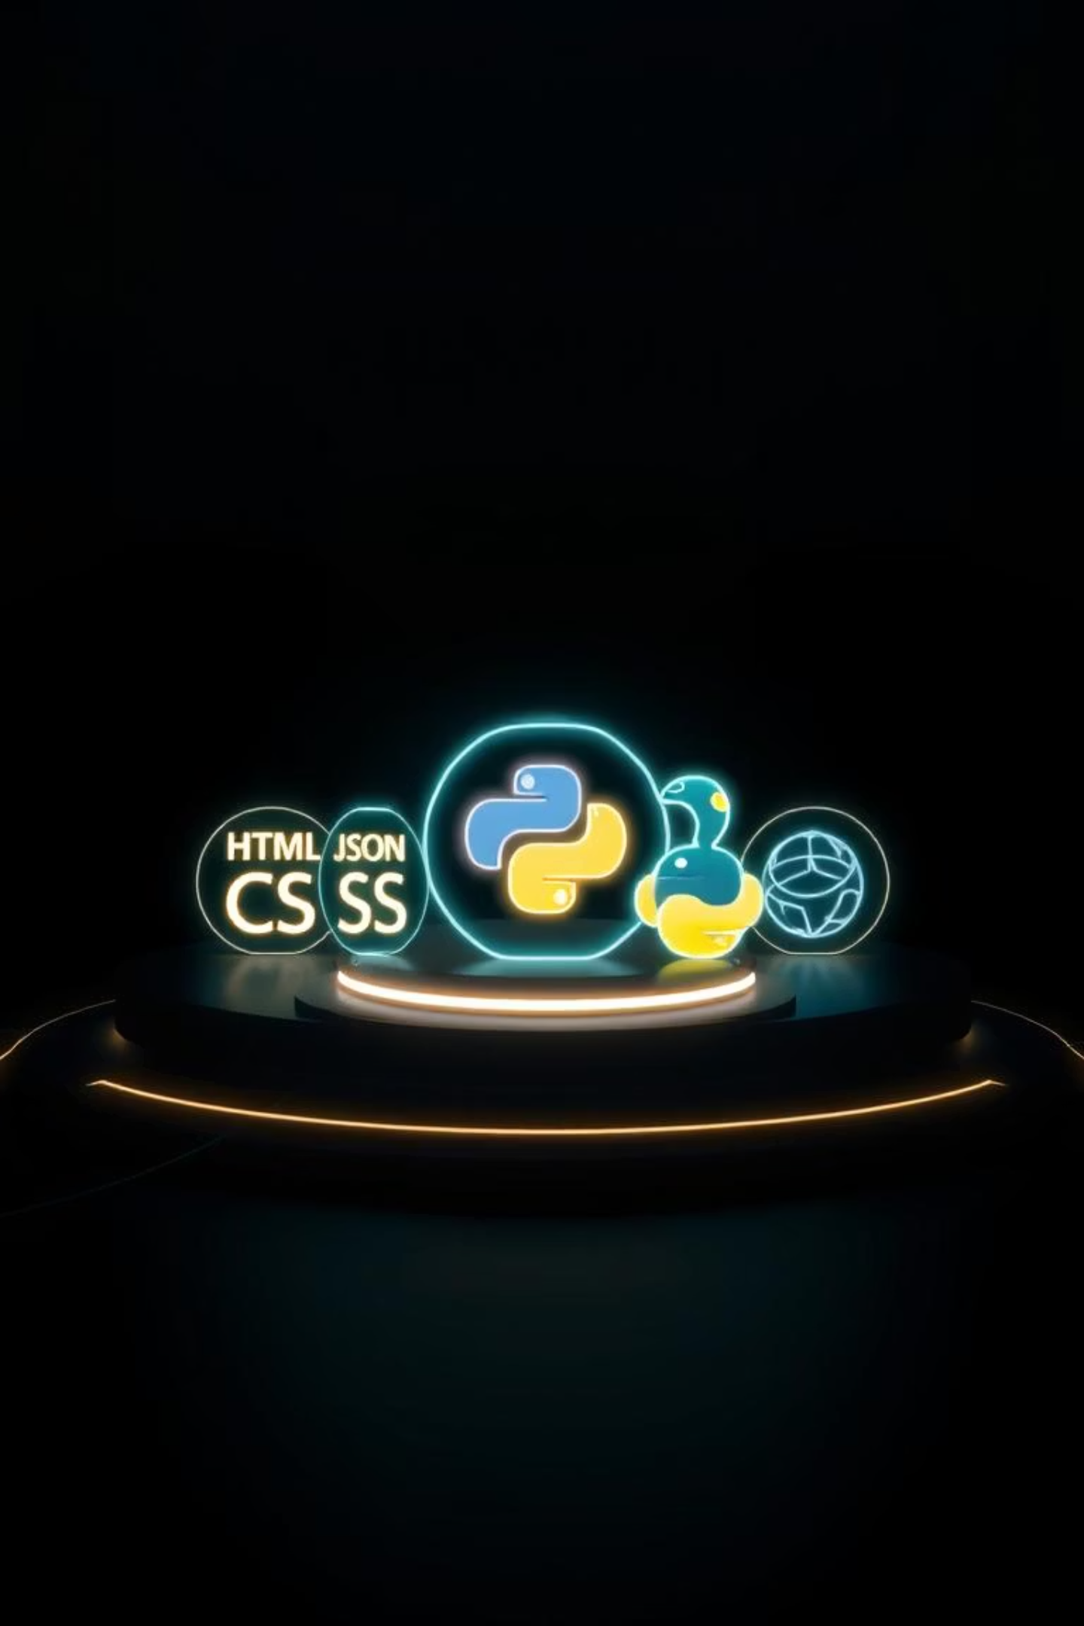




Technology Stack
Frontend
HTML, CSS, JavaScript for a responsive and intuitive user interface.
Backend
Python and Flask, with Flask-CORS for secure cross-origin requests.
Data Storage
Lightweight JSON files simulate database operations for user data.
Development Tools
VS Code for development and GitHub for version control and collaboration.

Slide 5
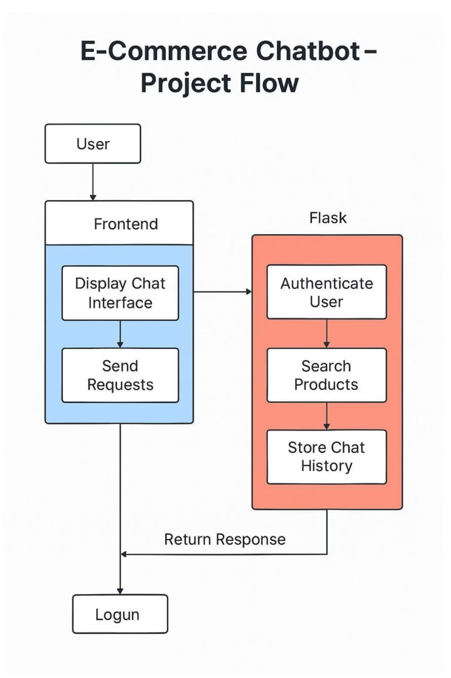
Architecture & Data Flow
The system architecture separates the frontend, which handles user interaction, from the Flask backend, which manages business logic and data persistence. API routes such as /login, /chat, and /history/ facilitate seamless communication between these layers. The backend interacts directly with JSON files, serving as a lightweight, file-based database for storing and retrieving user and chat data.

Slide 6
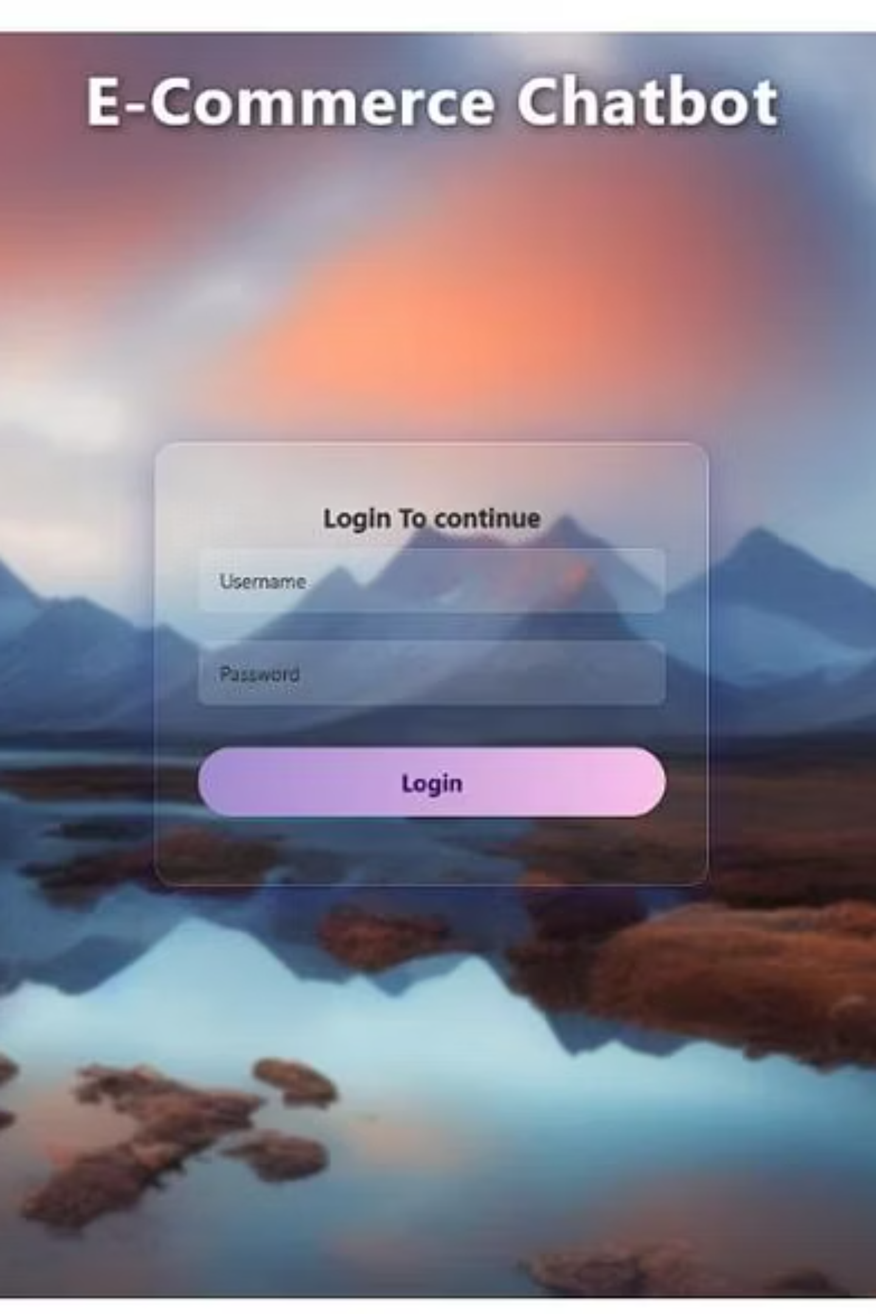
User Interface & Interaction
The chatbot's intuitive user interface allows for easy product inquiries and displays chat history clearly. Users can log in to access their past conversations and seamlessly continue their interactions. The system only responds with product names pre-stored in the products.json{" "} file, ensuring data integrity and consistency.

Slide 7

Key Learnings & Takeaways
Full-Stack Development
Gained comprehensive experience in building and integrating frontend and backend systems.
API Interaction
Deepened understanding of how frontend and backend communicate through RESTful APIs, particularly with JavaScript's Fetch API.
Data Persistence
Learned to manage manual user authentication and persist user data using JSON files.
Project Management
Enhanced skills in project structuring, GitHub for version control, and professional documentation.

Slide 8


Conclusion & Future Outlook
This e-commerce chatbot project provided invaluable practical experience in full-stack web development, bridging theoretical knowledge with real-world application. It underscored the importance of seamless frontend-backend integration and robust data management. I am grateful to Uplyft.ai for this challenging and insightful internship opportunity, which has significantly boosted my problem-solving abilities and prepared me for collaborative team environments.

